Slide 1
Blacktown Chinese Christian Church
Welcome to Our English Service 10.08.2025
English Service 9:45 – 11:00 am
Worship Songs: Passage: Speaker: Topic: Response Song: Announcements and Closing Prayer Benediction
1Kings 19:1-18 Combined Service The Danger of Discouragement TBA

Slide 2
BCCC english service

Slide 3

Please keep all phones on silent

Slide 4
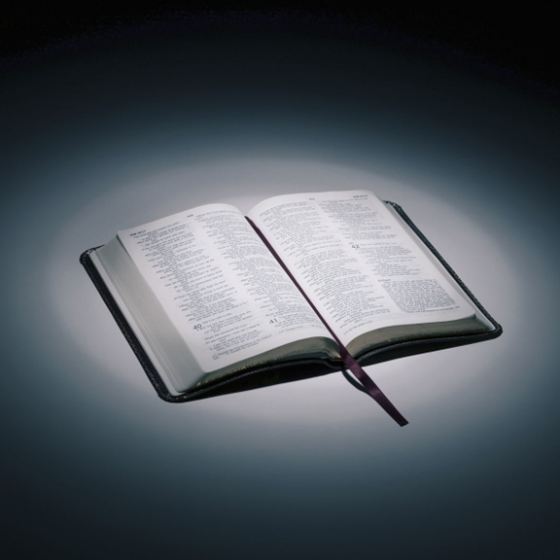
Bible reading

Slide 5
1Kings 19:1-18
Now Ahab told Jezebel everything Elijah had done and how he had killed all the prophets with the sword. ² So Jezebel sent a messenger to Elijah to say, “May the gods deal with me, be it ever so severely, if by this time tomorrow I do not make your life like that of one of them.”

Slide 6
1Kings 19:1-18
³ Elijah was afraid and ran for his life. When he came to Beersheba in Judah, he left his servant there, ⁴ while he himself went a day’s journey into the wilderness. He came to a broom bush, sat down under it and prayed that he might die. “I have had enough, Lord,” he said. “Take my life; I am no better than my ancestors.”

Slide 7
1Kings 19:1-18
⁵ Then he lay down under the bush and fell asleep.
All at once an angel touched him and said, “Get up and eat.” ⁶ He looked around, and there by his head was some bread baked over hot coals, and a jar of water. He ate and drank and then lay down again.

Slide 8
1Kings 19:1-18
⁷ The angel of the Lord came back a second time and touched him and said, “Get up and eat, for the journey is too much for you.” ⁸ So he got up and ate and drank. Strengthened by that food, he traveled forty days and forty nights until he reached Horeb, the mountain of God.

Slide 9
1Kings 19:1-18
⁹ There he went into a cave and spent the night.
And the word of the Lord came to him: “What are you doing here, Elijah?”
¹⁰ He replied, “I have been very zealous for the Lord God Almighty. The Israelites have rejected your covenant, torn down your altars, and put your prophets to death with the sword. I am the only one left, and now they are trying to kill me too.”

Slide 10
1Kings 19:1-18
¹¹ The Lord said, “Go out and stand on the mountain in the presence of the Lord, for the Lord is about to pass by.”
Then a great and powerful wind tore the mountains apart and shattered the rocks before the Lord, but the Lord was not in the wind. After the wind there was an earthquake, but the Lord was not in the earthquake. ¹² After the earthquake came a fire, but the Lord was not in the fire. And after the fire came a gentle whisper.

Slide 11
1Kings 19:1-18
¹³ When Elijah heard it, he pulled his cloak over his face and went out and stood at the mouth of the cave.
Then a voice said to him, “What are you doing here, Elijah?”
¹⁴ He replied, “I have been very zealous for the Lord God Almighty. The Israelites have rejected your covenant, torn down your altars, and put your prophets to death with the sword. I am the only one left, and now they are trying to kill me too.”

Slide 12
1Kings 19:1-18
¹⁵ The Lord said to him, “Go back the way you came, and go to the Desert of Damascus. When you get there, anoint Hazael king over Aram. ¹⁶ Also, anoint Jehu son of Nimshi king over Israel, and anoint Elisha son of Shaphat from Abel Meholah to succeed you as prophet.

Slide 13
1Kings 19:1-18
¹⁷ Jehu will put to death any who escape the sword of Hazael, and Elisha will put to death any who escape the sword of Jehu. ¹⁸ Yet I reserve seven thousand in Israel—all whose knees have not bowed down to Baal and whose mouths have not kissed him.”

Slide 14
Announcements

Slide 15





Account name: Blacktown Chinese Christian Church
Account number: 4216 50263
Offering
BSB: 112 - 879
Please put in "offering" as the reference
The offering box is available at the back of the hall

Slide 16
Prayer points

Slide 17
Mingle time!

